Slide 1
CodeVault

Slide 2
General overview
The problem: It could be really hard for people to find the right person and solution for an IT problem he has
The solution: We give a platfrom for the users where you can post your problem and people can solve it for money, the solution is rated by our professionals.

Slide 3
Functionality
Rather then having the IT users upload papers, it works by portfolio, and ratings
Built-in functions:
User, Code rating
File, Request uploading
Admin page
Chat platfrom

Slide 4
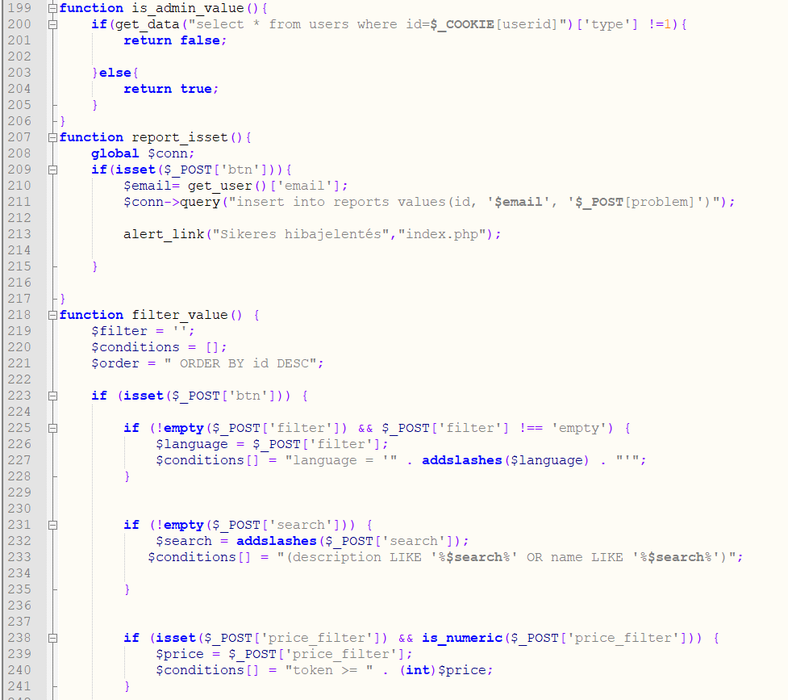
Teamwork
Approach
Oliver:
Database design
Backend development
Database coding

Slide 5
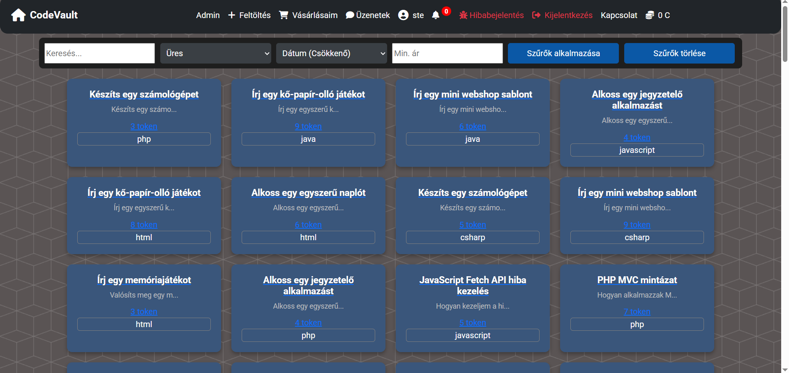
Teamwork
Krisztian:
Frontend design
Documentation
Testing

Slide 6
Technologies & Tools used
Software and tools:
Visual Studio Code
Google Drive
PhpMyAdmin
Github
Languages:
Html, Css
JavaScript, Php
SQL
Framewoks:
Bootstrap

Slide 7
Database
Sql:
MySql
PhpMyAdmin
Stored data:
Users
Chats
Files
Messges
Codes for registration
User ratings

Slide 8
Database
Stored data:
Requests from users
Reports
Buy history

Slide 9
Testing
Files
Is virus proof
How large files can be uploaded
Are the files downloadable
Admin page
Is the admin page accessible by non-admin users
Can the admins edit the files

Slide 10
Challanges & future
Emerged issues:
Lack of clean code
The security of the website
Making the structure of the website, and functionality
Making the transactions functional (Legal issues)
What’s next:
Finishing the transactions function
Making the project more functional
Replacing the admins need for rating with AI

Slide 11
Thank you for listening!

